Slide 1
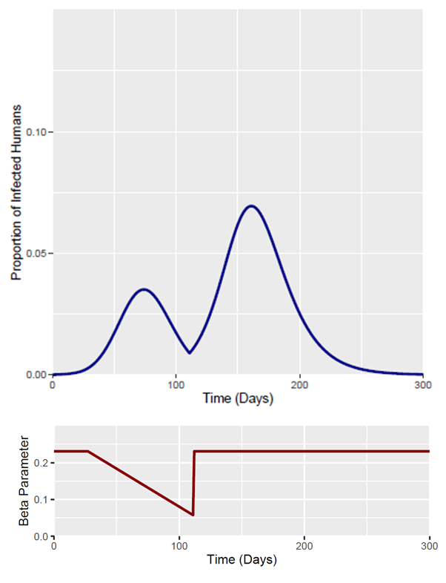
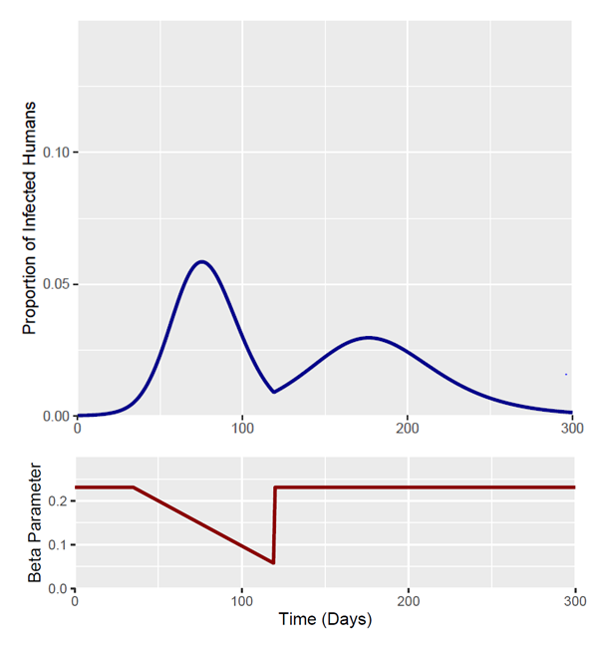
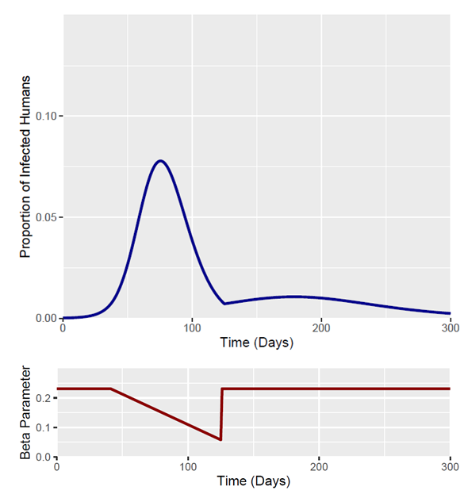
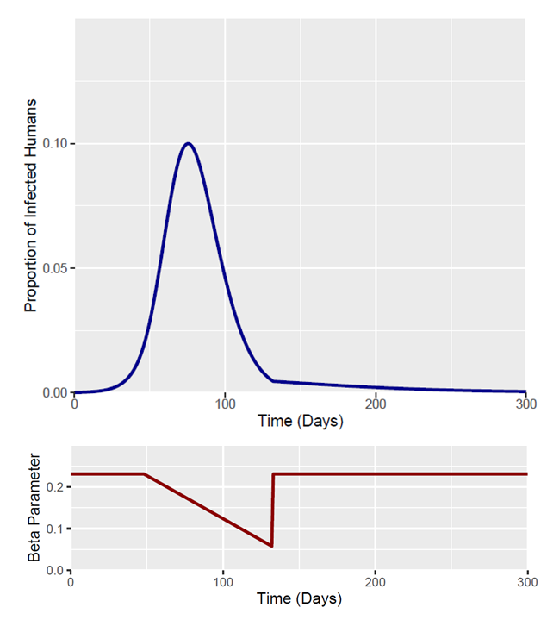
Output Measures | Day 27 | Day 35 | Day 41 - Baseline | Day 48
Total Fraction Infected | 0.719 | 0.65 | 0.585 | 0.57
Peak Fraction Infected | 0.069 | 0.058 | 0.0778 | 0.099
Time of Epidemic Peak | Day 161 | Day 75 | Day 76 | Day 75

Slide 2
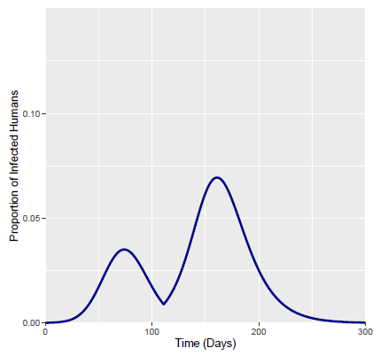
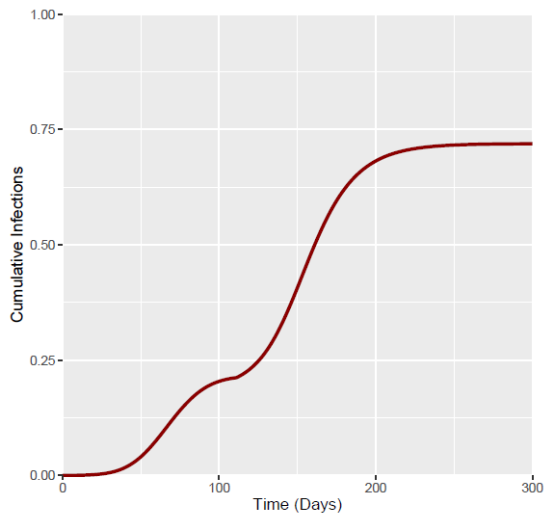
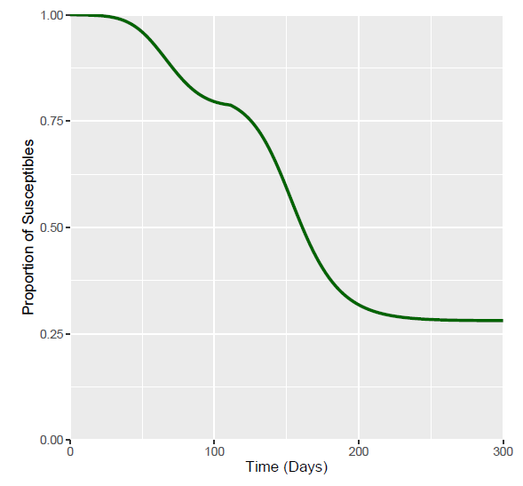
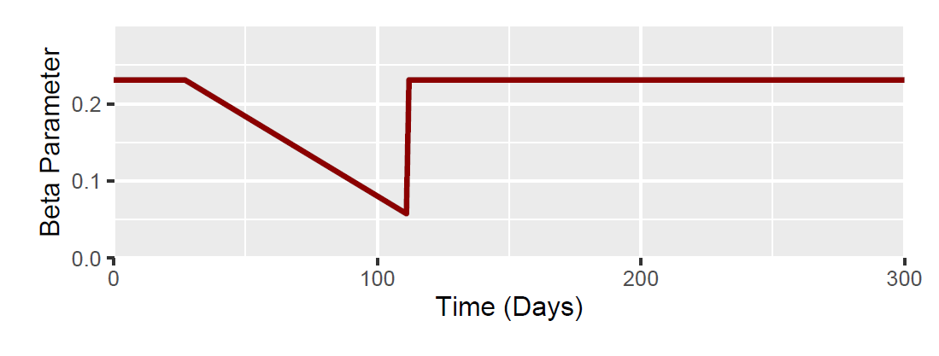
Day 27 (I at 27 Days = 0.002)
Output Measures | Value
Total Fraction Infected | 0.719
Peak Fraction Infected | 0.069
Time of Epidemic Peak | Day 161

Slide 3
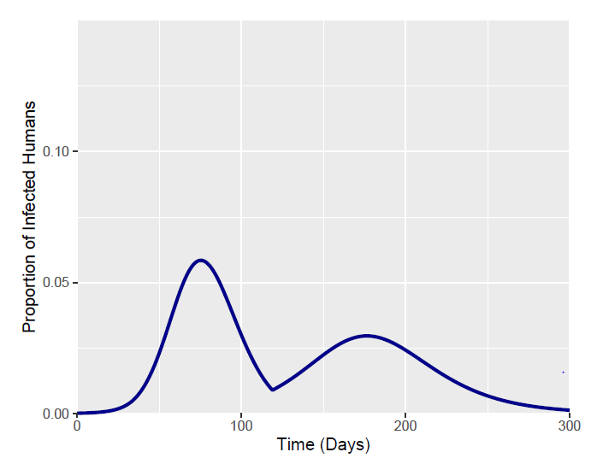
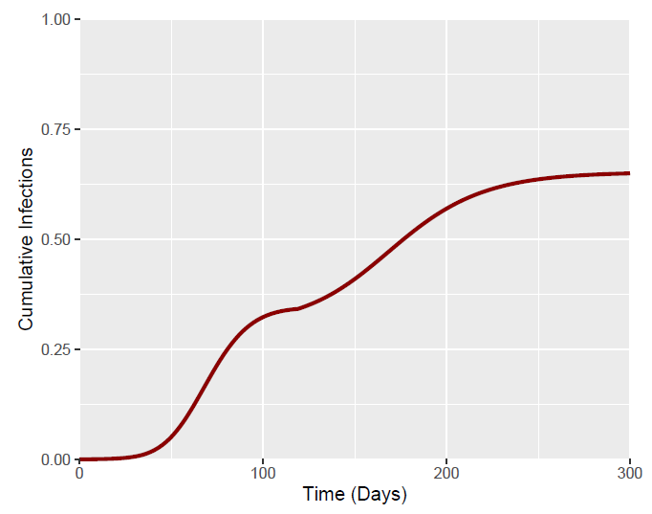
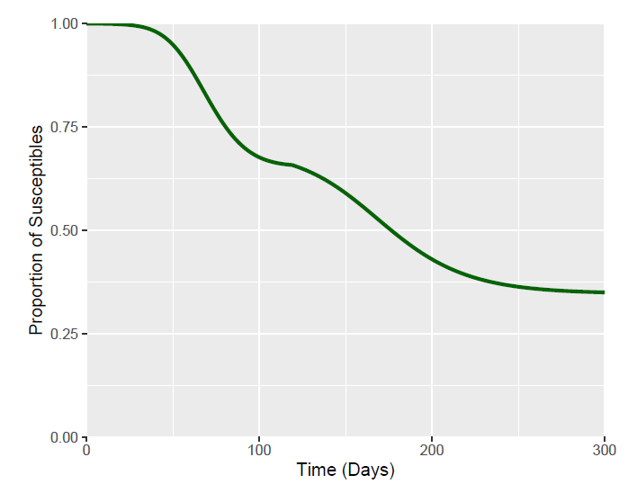
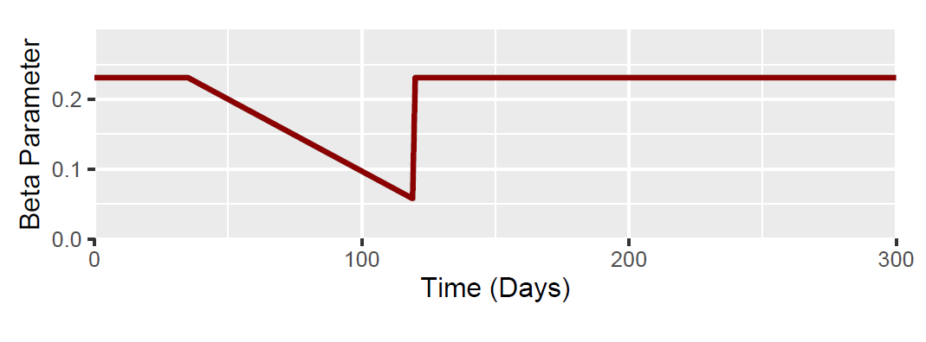
Day 35 (I at 35 Days = 0.0056)
Output Measures | Value
Total Fraction Infected | 0.65
Peak Fraction Infected | 0.058
Time of Epidemic Peak | Day 75

Slide 4
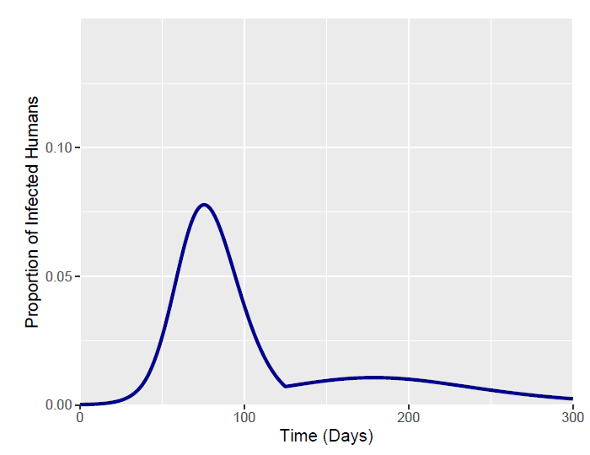
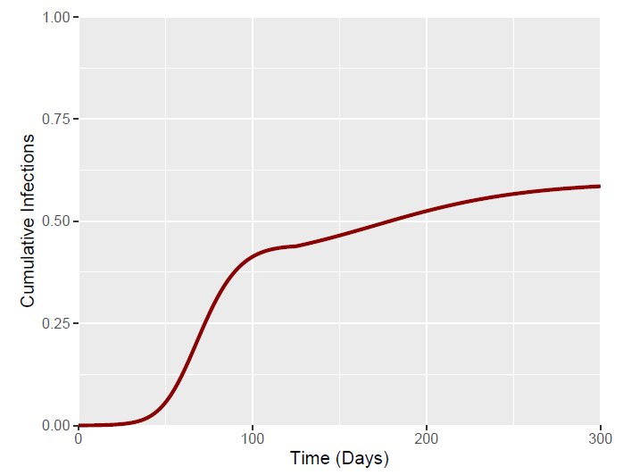
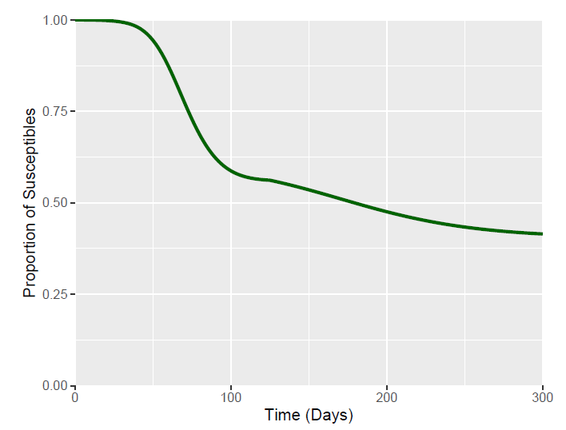
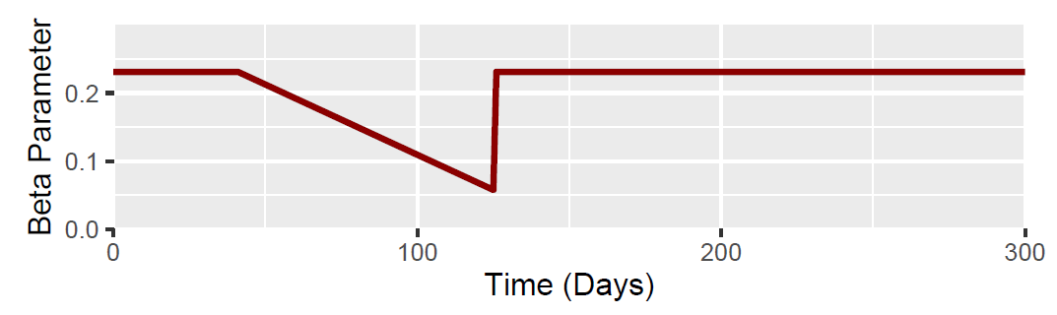
Day 41 - Baseline
Output Measures | Value
Total Fraction Infected | 0.585
Peak Fraction Infected | 0.0778
Time of Epidemic Peak | Day 76

Slide 5
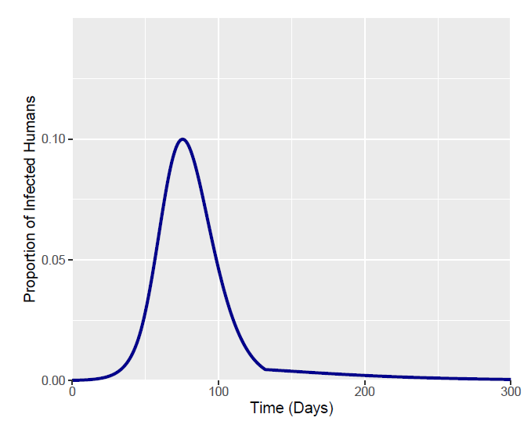
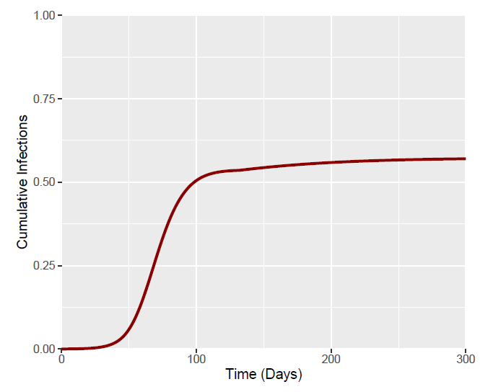
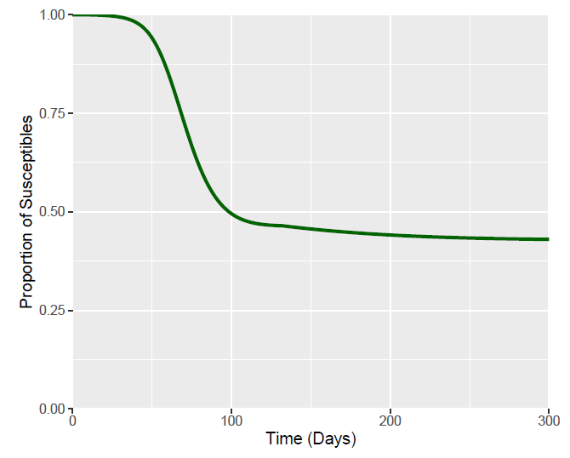
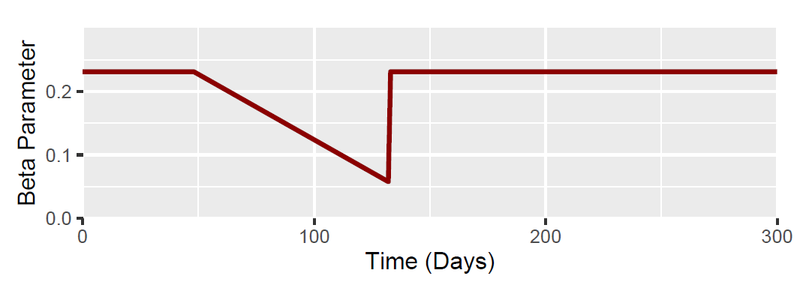
Day 48 (I at 48 Days = 0.023)
Output Measures | Value
Total Fraction Infected | 0.57
Peak Fraction Infected | 0.099
Time of Epidemic Peak | Day 75

